Slide 1
Review

Slide 2
Announcements
Will update Gradebook when Quiz6 and Quiz7 are out so you decide on Quiz8
Feedback about the online?
I tried to include Shorter CT
Will make it also short for upcoming assessments
Quizzes posted online - practice and reach to us if you have questions
I will include Guide sheets for you in the demo repo for graphics, animations, and strings
I believe some students have guide sheets for string from 110 -I will post this also for the ones who don't have it
Cheat Sheet for graphics will be included

Slide 3
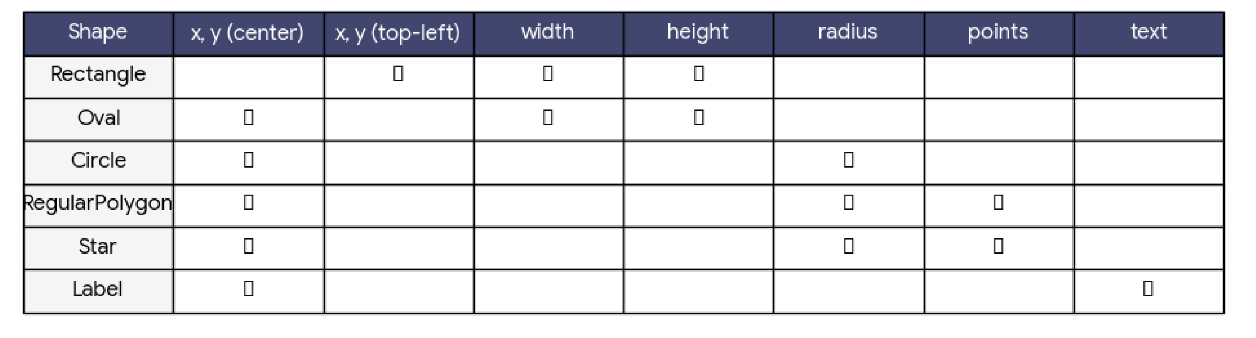
Graphics
Cheat Sheet will be given
Questions:
CT
FIB
FR
Get familiar with converting between (rowID to Y) and (colID to X)

Slide 4
Lists
Lists properties
Ordered, mutable, allow duplicates
Tuples properties:
Immutable lists: ordered and allow duplicates
List methods & Operations
Slicing, indexing, and iterating work as you did with Strings
L+=[e], count, sum, len, insert, append, del, remove, pop
Lists<> Strings: split and join
Merging lists: + , extends
(is vs ==)
Destruction
Understand the difference between: modifying a mutable object (Destructive) VS rebinding a variable name to a new object that a non-destructive operation created
Destructive Vs Non-Destructive Operations
l.f() are usually destructive ...
l.append, l.sort, l.extend, l.remove, l.reverse()
Adding: L1+=L2 (updates L1), L1+=[e]
Updating Elements: L[:]= [1,2,3,4] slide assignment, L[1] = e
f(l) are not destructive, original doesn't change and a new copy is created
sorted(l), sum(l), len(l)
L1 = L1+L2 creates a new list
L[::-1] new list reversed
How do you create a destructive vs a non-destructive function
Should never modify the list as you iterate over it

Slide 5
Lists
Aliasing
Two names for the same object in memory
Any modifications made to the list using one alias will affect the list when accessed through any other alias
Two Cases
L1 = L2,
function parameters
Creating Proper copy
L2 = copy.copy(L1)
L2 = L1[::]
You have to Draw in CT
Allocated memory
This is the memory where objects (values) are stored
Lists, strings, numbers, etc. live here
Objects stay in allocated memory as long as something refers to them
Think: the actual data lives here
Local memory
This is where variable names inside a function live
Names are local to the function and disappear when the function ends
Local variables point to objects in allocated memory
Think: labels pointing to the data

Slide 6
2D Lists
Aliasing
Shallow Copy
L2 = L1[::]
L2 = copy.copy(L1)
Deeopcopy
L2 = copy.deepcopy(L1)
You have to draw on CT

Slide 7
Animations
Animations guide Sheet
MVC
Take notes of what needs to be done in each function as you read the question

